Slide 2
Praise be to the God and Father of our Lord Jesus Christ, who has blessed us in the heavenly realms with every spiritual blessing in Christ.

Slide 5
Praise be to the God and Father of our Lord Jesus Christ, who has blessed us in the heavenly realms with every spiritual blessing in Christ.

Slide 6
In Christ,
we've been chosen. (v4-6)

Slide 8
Predestination
The Bible presents predestination as a positive doctrine.

Slide 9
Predestination
The Bible presents predestination as a positive doctrine.
God's choice doesn't take away our responsibility.

Slide 10
Predestination
The Bible presents predestination as a positive doctrine.
God's choice doesn't take away our responsibility.
We don't know who God has chosen.

Slide 11
adopted to sonship

Slide 12
2. In Christ,
we're redeemed. (v7-10)

Slide 13
redeem

Slide 15
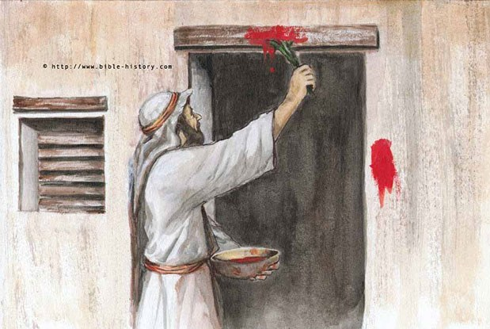
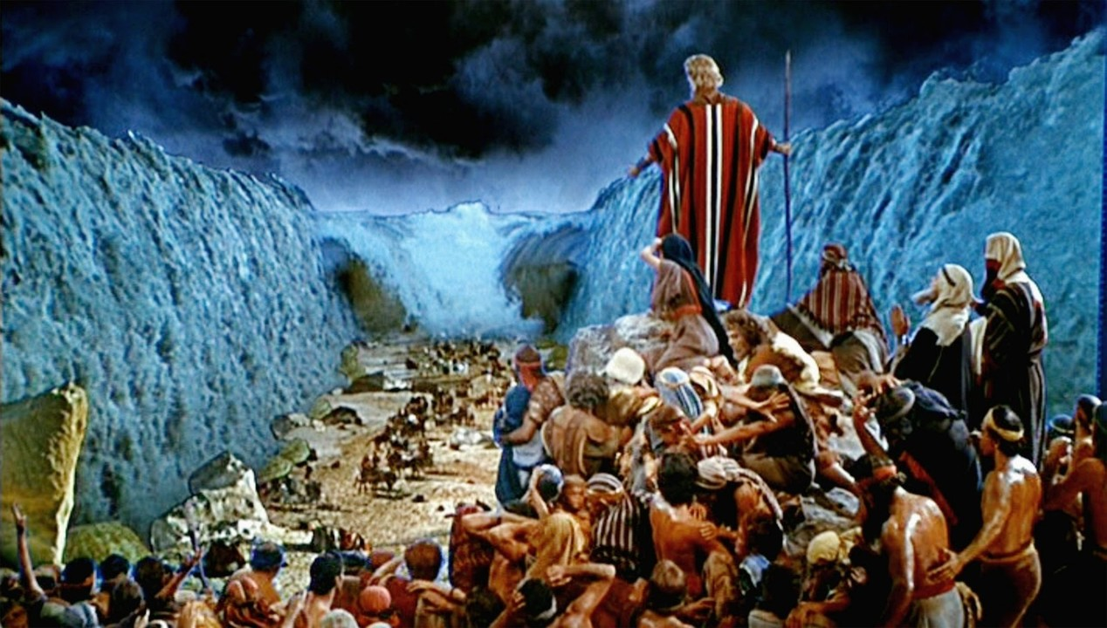

Slide 16
