Slide 1
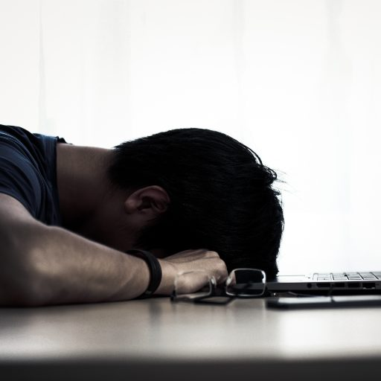
feeling weak

Slide 2
1. The patient LORD

Slide 3
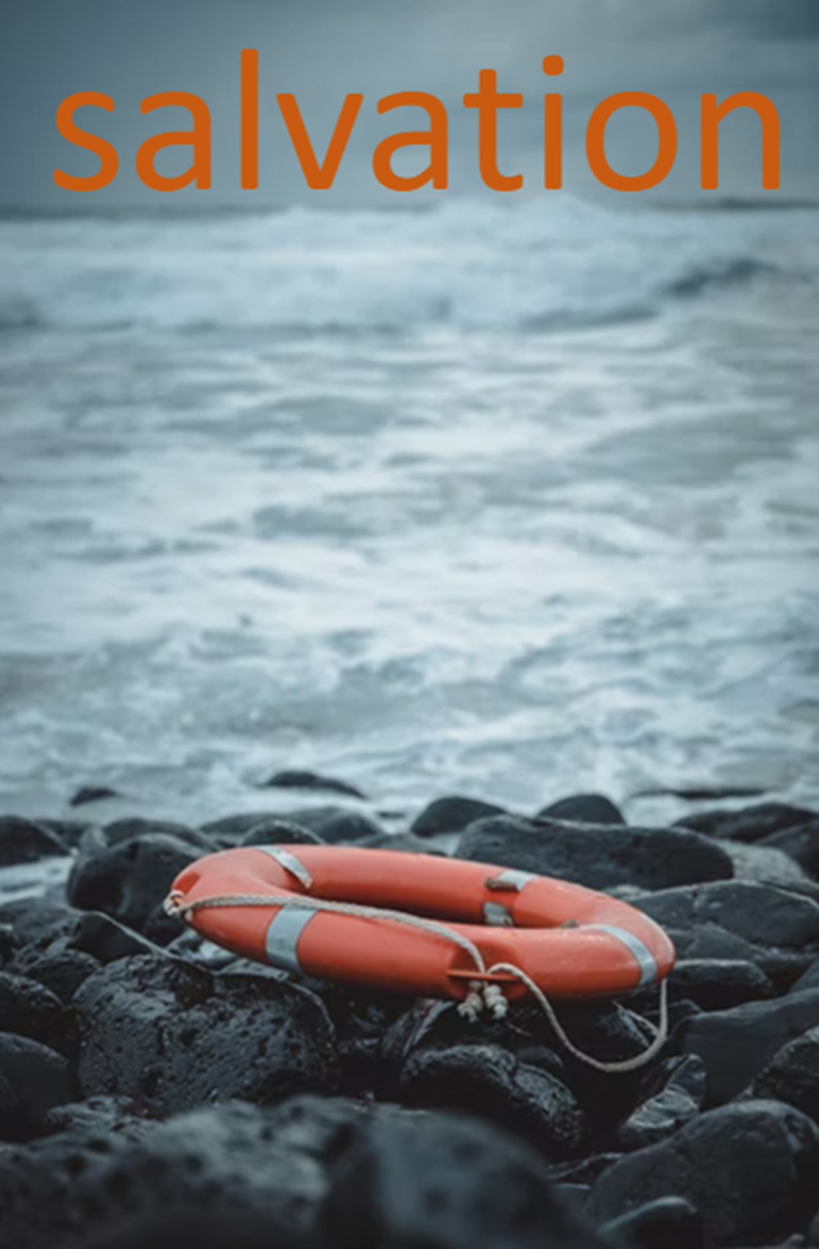
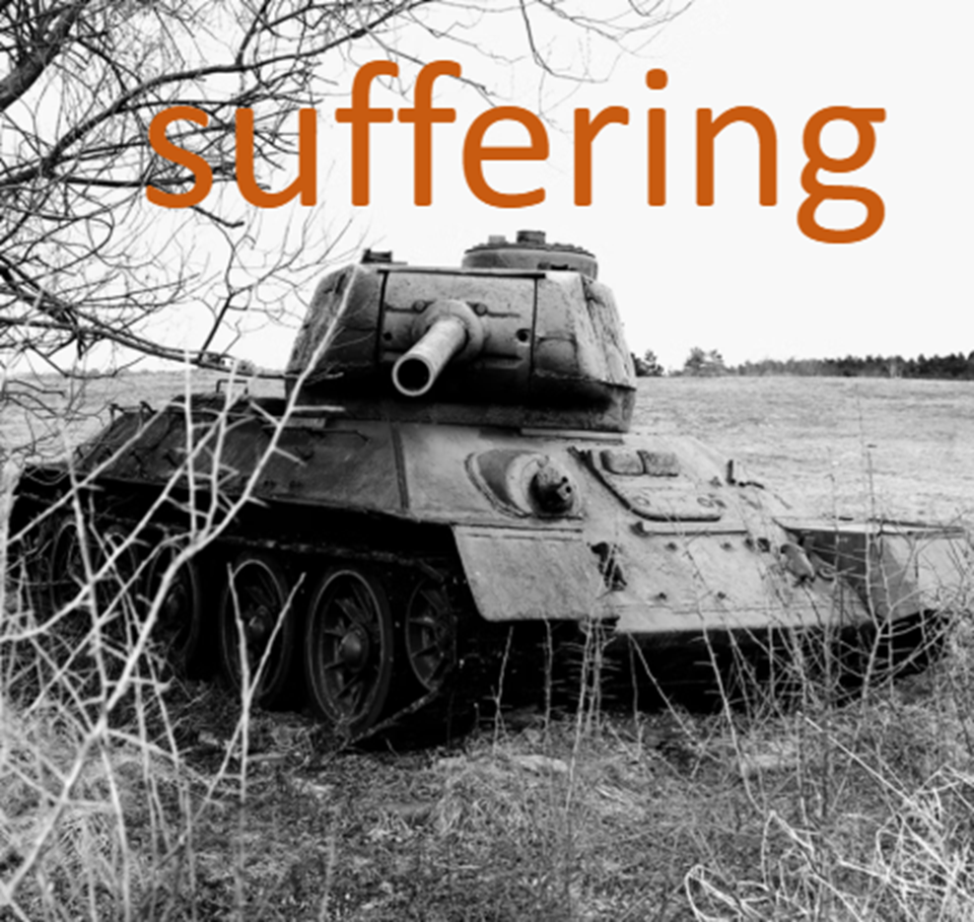

Slide 4
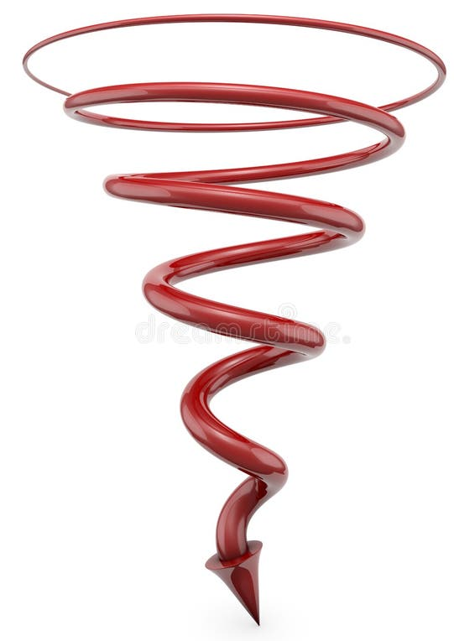

Slide 5
"I said to you, ‘I am the Lord your God; do not worship the gods of the Amorites, in whose land you live.’ But you have not listened to me.”
Judges 6:10

Slide 6
The biggest problem:

Slide 8
2. The strong LORD

Slide 9
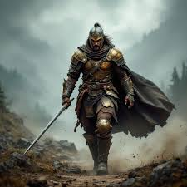
"The LORD is with you, mighty warrior.”
Judges 6:11

Slide 10
Jesus was
crucified in weakness

Slide 11
3. The sovereign LORD

Slide 12
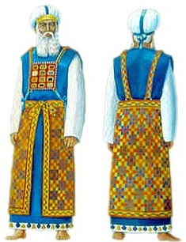
the ephod:
the high priest's God-given tool for gaining God's wisdom

Slide 13
A warning and an encouragement

