Slide 1
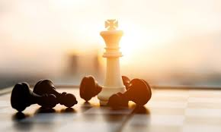

Slide 2
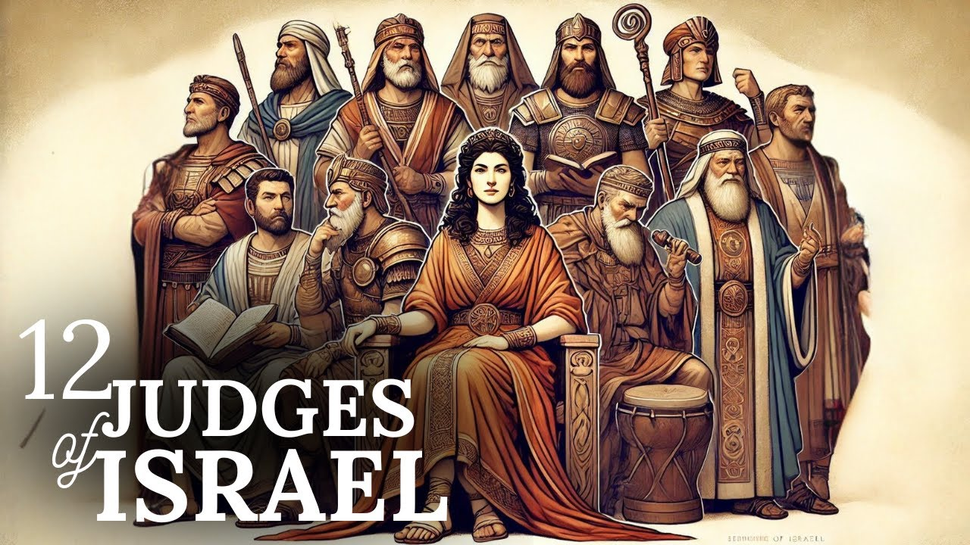

Slide 3
A merciful God
An impotent enemy
A surprising deliverance

Slide 4
A merciful God
An impotent enemy
A surprising deliverance

Slide 7
A merciful God
An impotent enemy
A surprising deliverance

Slide 8
Eglon king of Moab

Slide 10
A merciful God
An impotent enemy
A surprising deliverance

Slide 12
