Slide 2
dead in sins
alive with Jesus

Slide 4
The before
– left out & on their own
(v11-12)

Slide 5
remember that at that time you were separate from Christ, excluded from citizenship in Israel and foreigners to the covenants of the promise, without hope and without God in the world
<

Slide 6
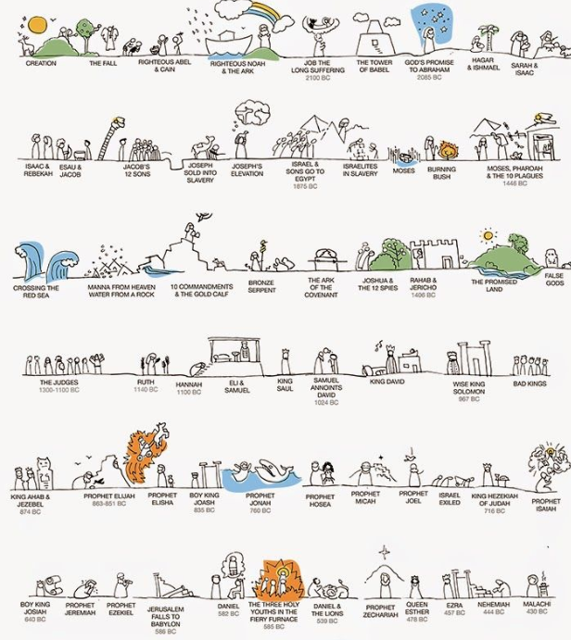

Slide 8
remember that at that time you were separate from Christ, excluded from citizenship in Israel and foreigners to the covenants of the promise, without hope and without God in the world
<

Slide 9
By...
God's design

Slide 10
By...
God's design
God's people's sin

Slide 13
The before
– left out & on our own
(v11-12)

Slide 14
But now in Christ Jesus you who once were far away have been brought near by the blood of Christ. 14 For he himself is our peace
<

Slide 15
The after
– friends with God & each other
(v13-22)

Slide 17
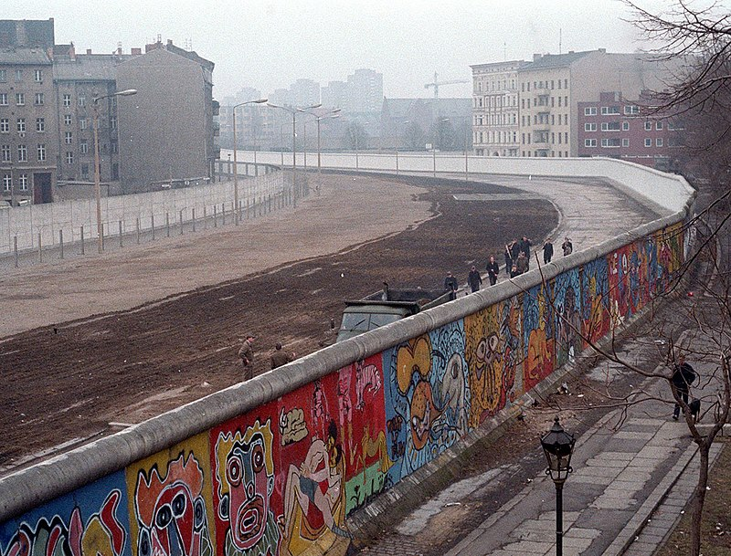
reconciled

Slide 18
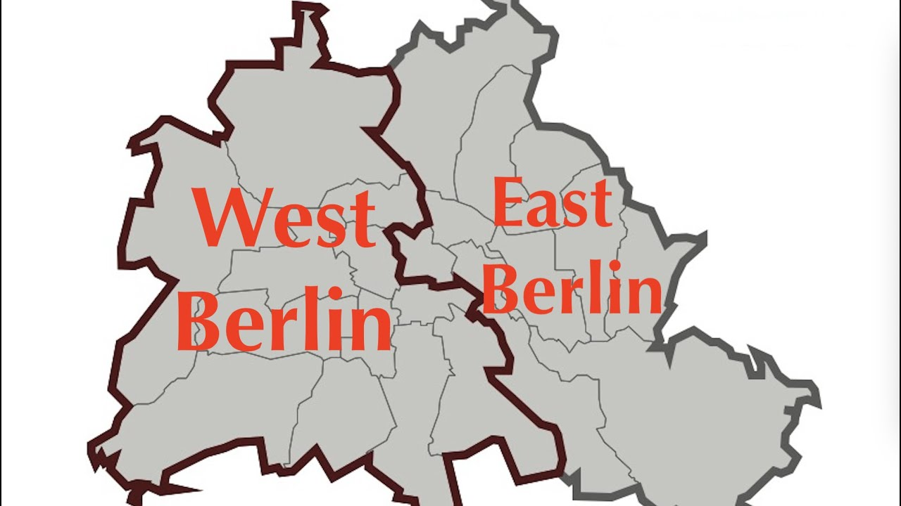

Slide 19
reconciliation

Slide 20
friends with each other
the law

Slide 21
friends with God
our sin

Slide 22
in him you too are being built together to become a dwelling in which God lives by his Spirit.
<

