Slide 1
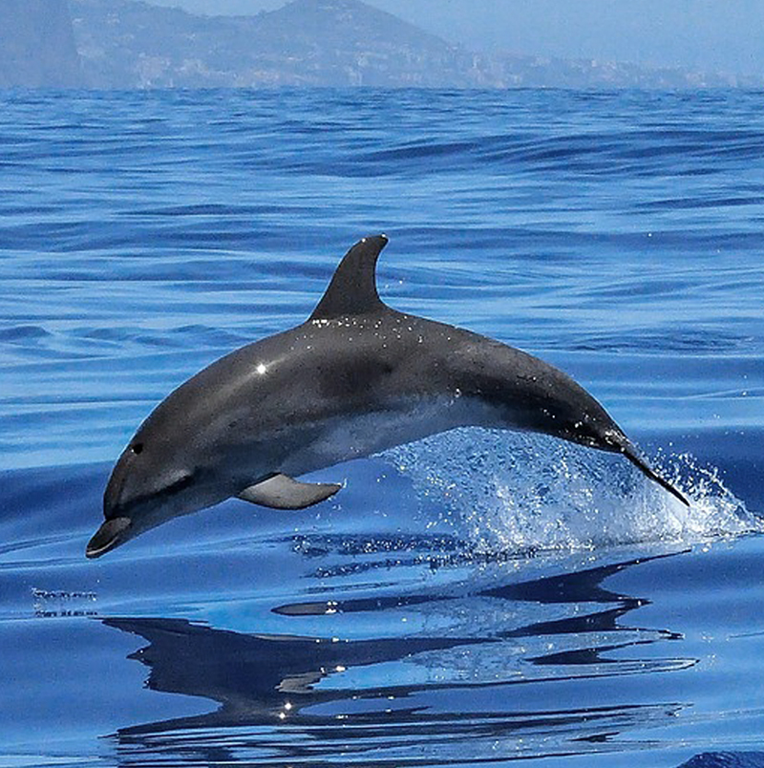
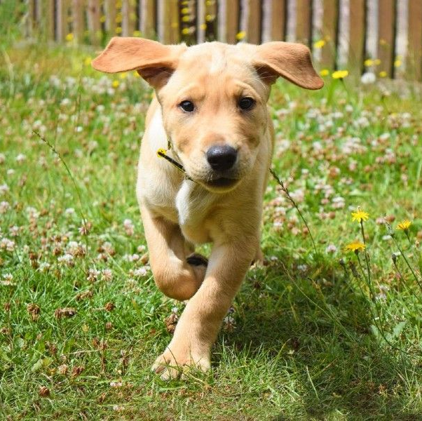
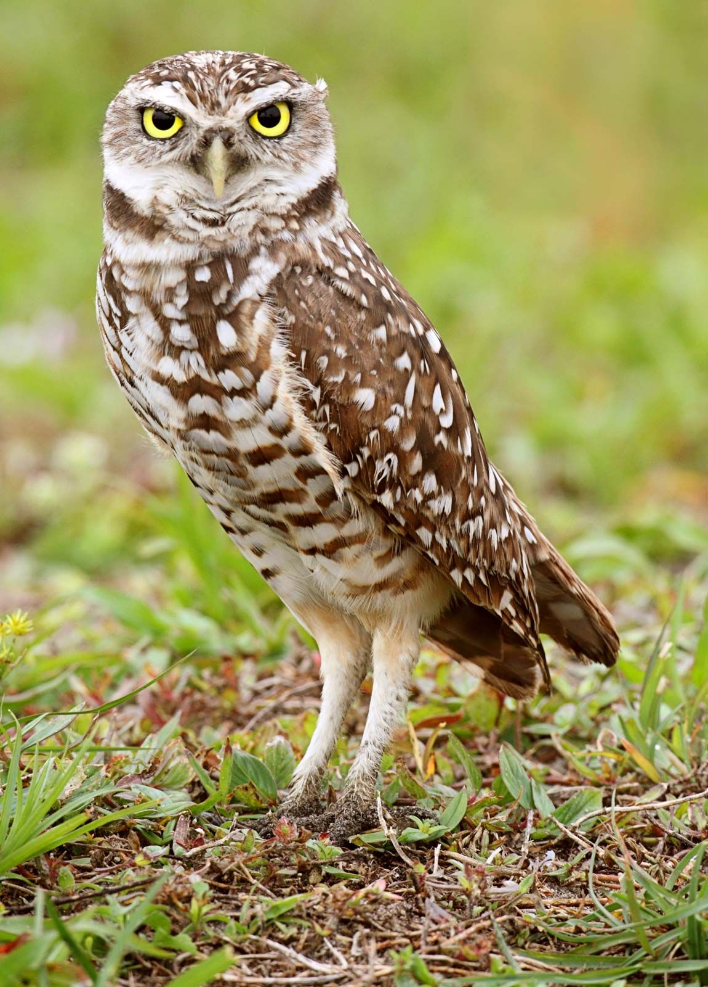

Slide 3
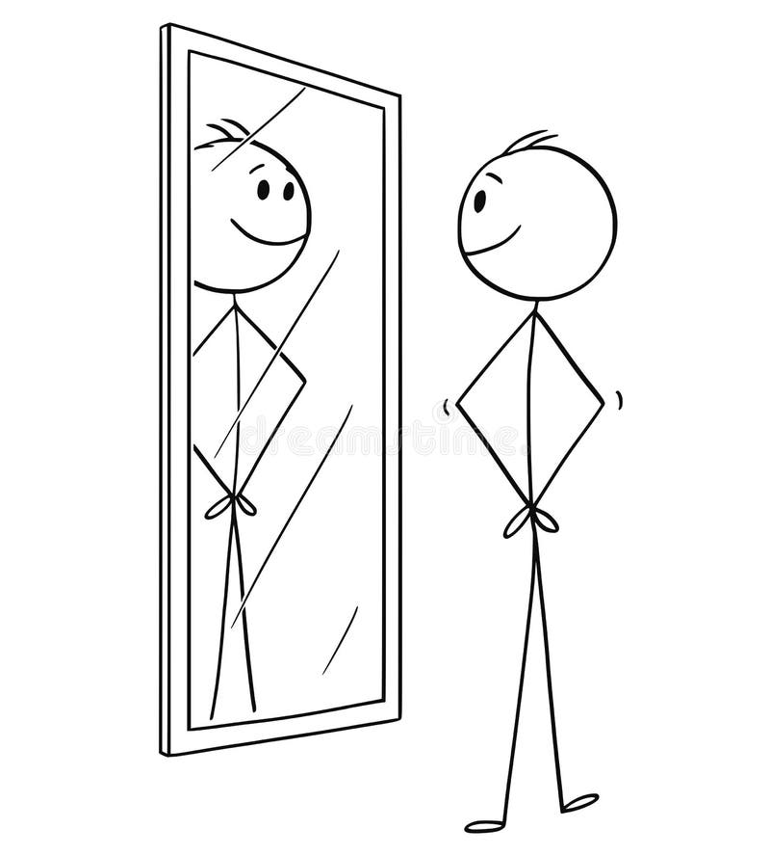

Slide 4
What does Jesus see
when he looks at us human beings?

Slide 5
When he saw the crowds, he had compassion on them, because they were harassed and helpless, like sheep without a shepherd.

Slide 6
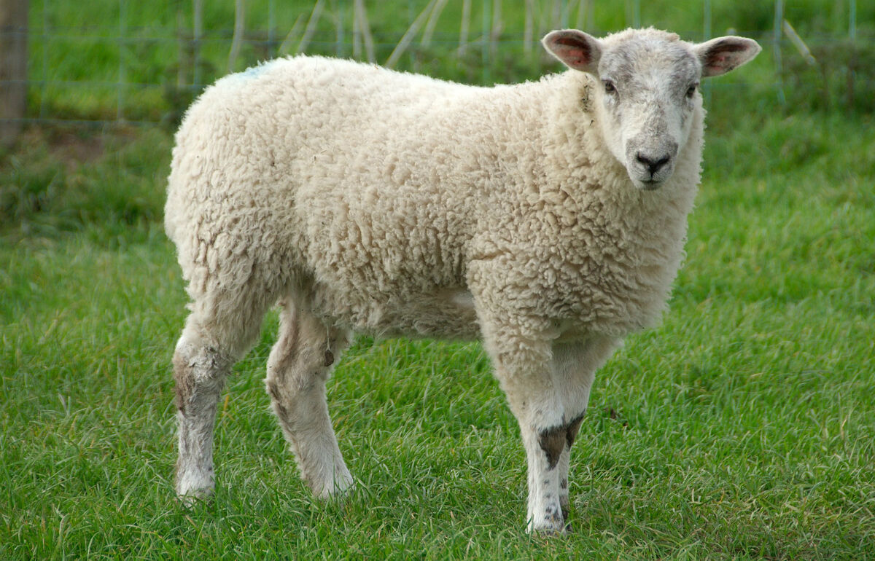

Slide 9
When he saw the crowds, he had compassion on them, because they were harassed and helpless, like sheep without a shepherd.

Slide 12
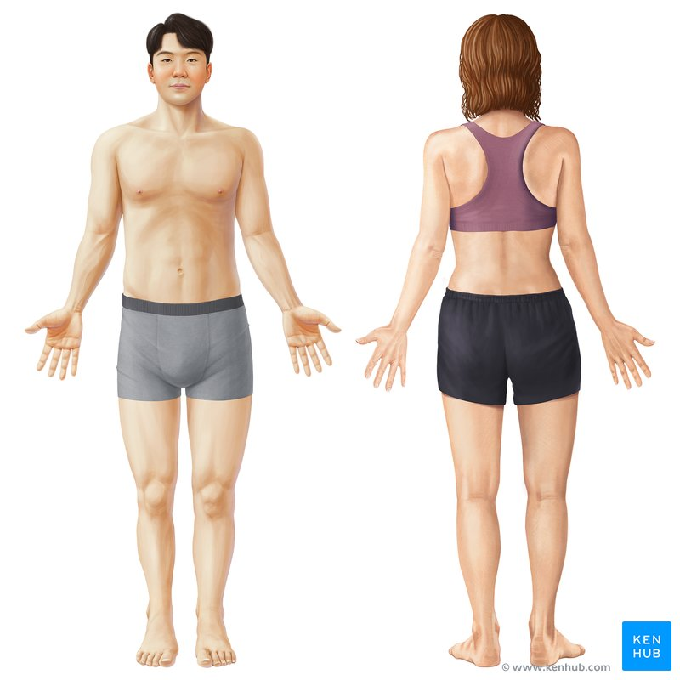

Slide 14
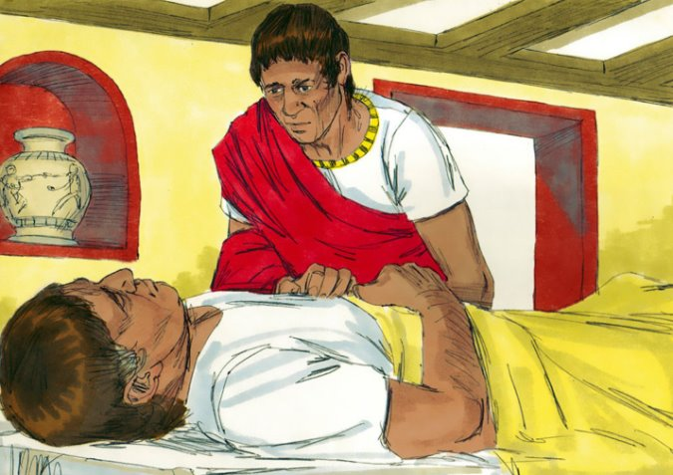
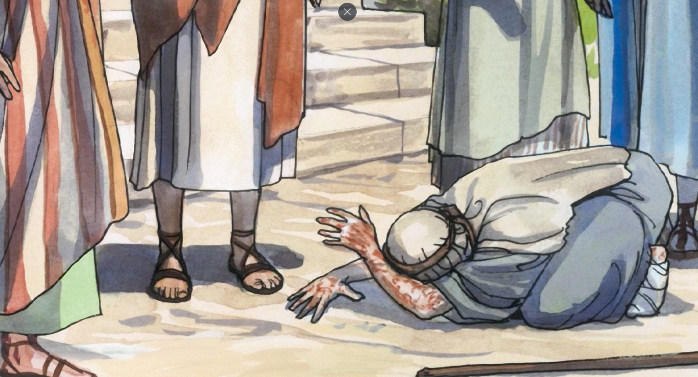
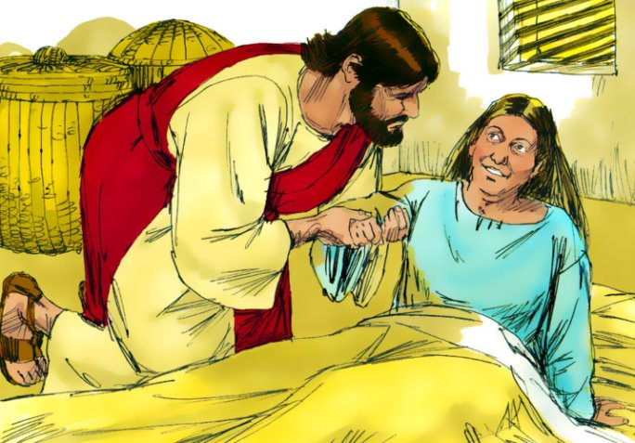
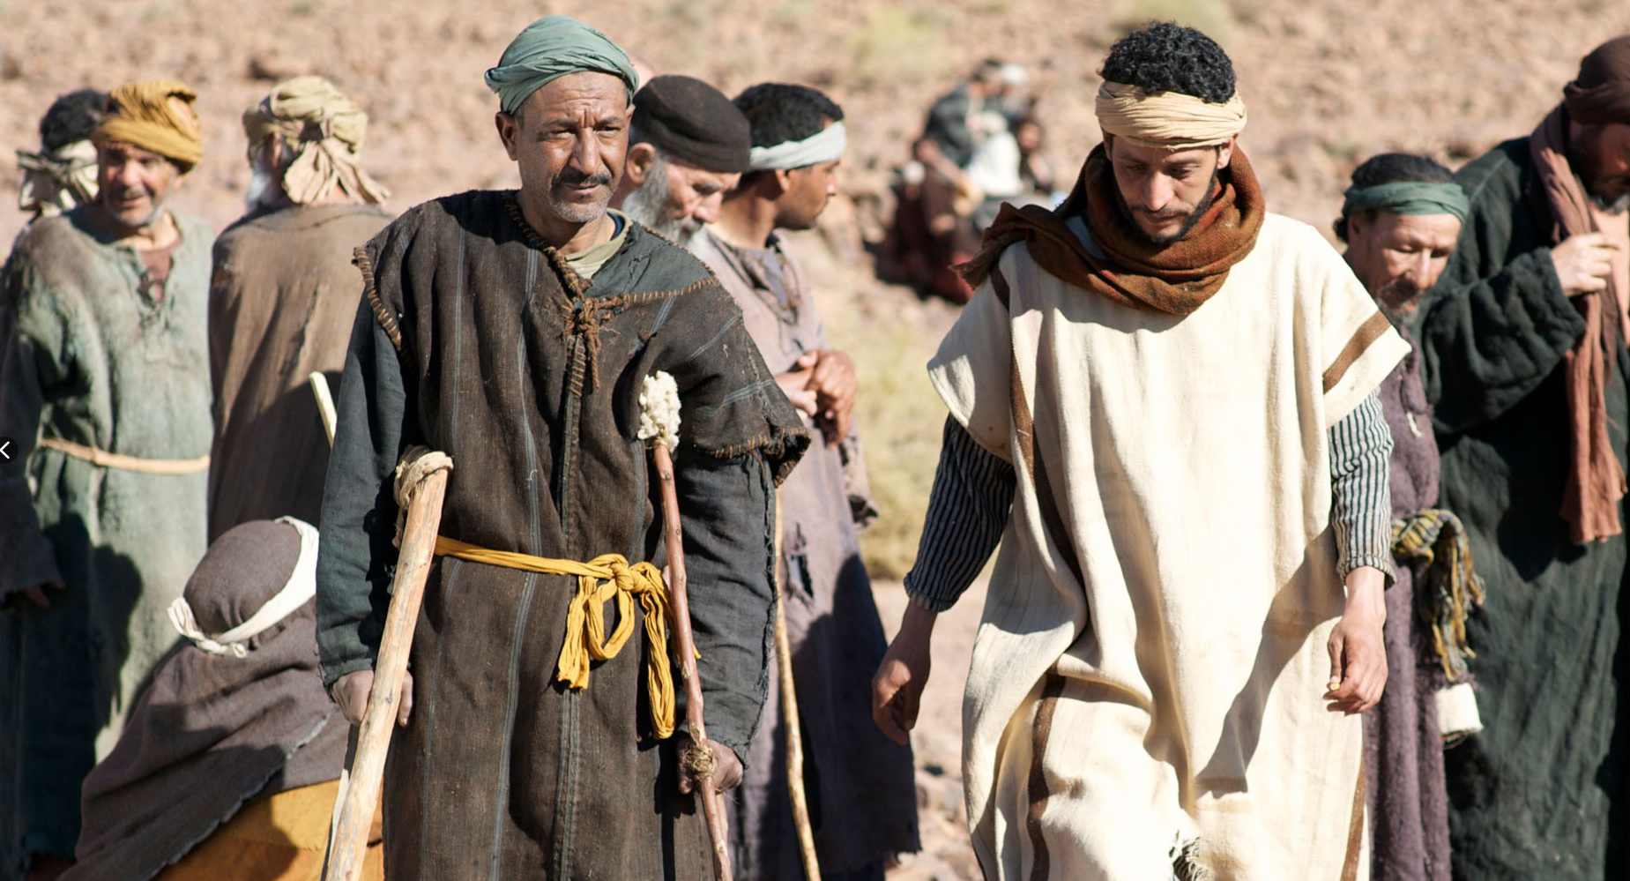

Slide 16
2. How does Jesus feel
when he sees the state we're in?

Slide 17
...disappointed...?

Slide 18
...disappointed?
...frustrated?

Slide 19
...disappointed?
...frustrated?
...angry?

Slide 20
When he saw the crowds, he had compassion on them, because they were harassed and helpless, like sheep without a shepherd.

Slide 21
compassion

Slide 22
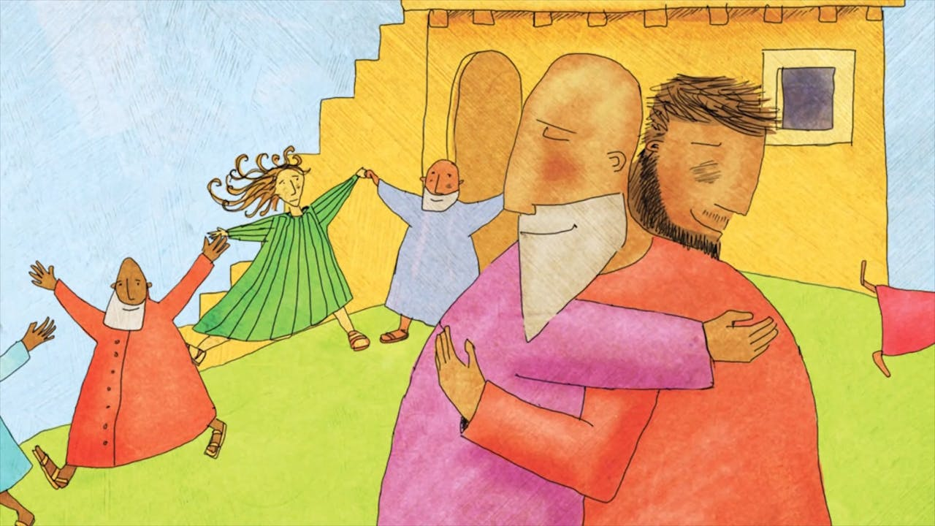

Slide 23
compassion

Slide 25
compassion

Slide 26
3. What does Jesus do
when he sees the state we're in?

Slide 27
Jesus went through all the towns and villages, teaching in their synagogues, proclaiming the good news of the kingdom and healing every disease and sickness.

Slide 28
compassion

Slide 29
Jesus taught the Bible

Slide 30
Jesus taught the Bible
Jesus announced the good news

Slide 31
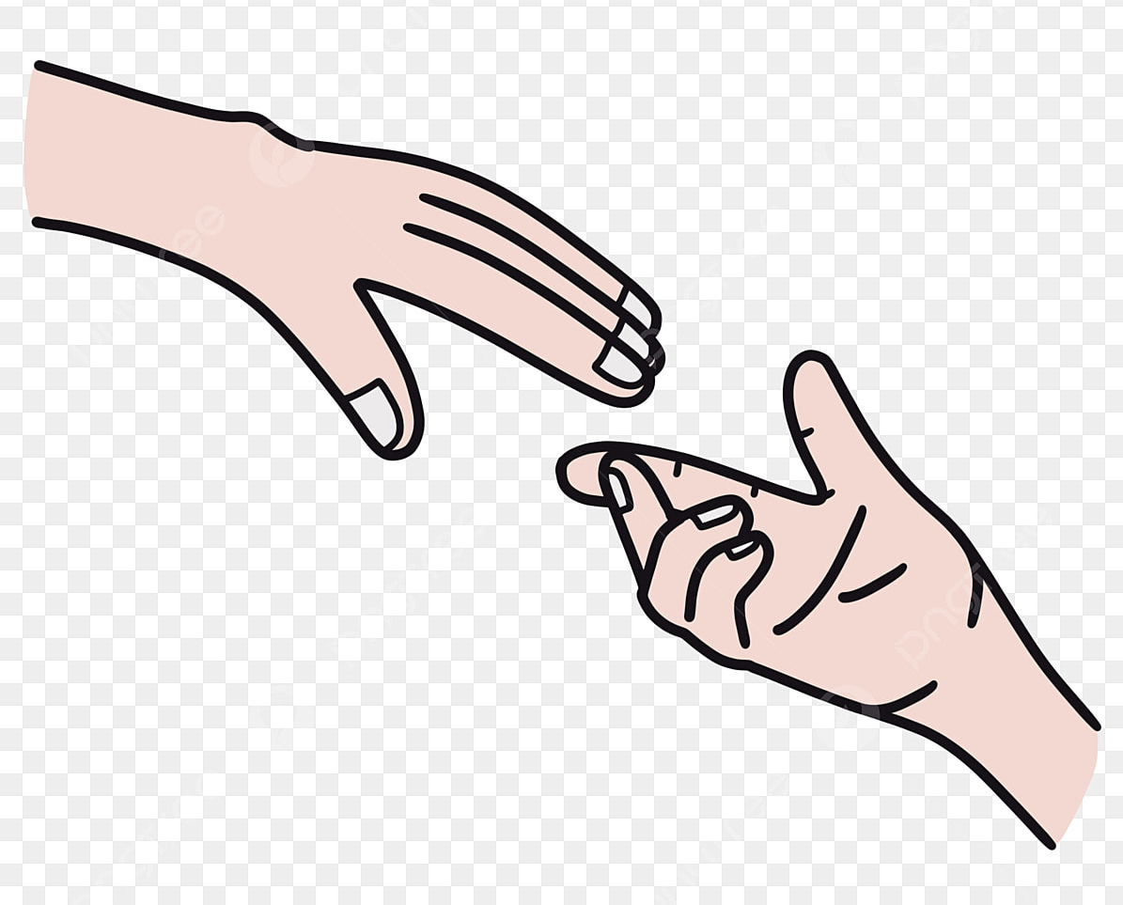
Jesus taught the Bible
Jesus announced the good news
Jesus healed people

Slide 32
Jesus went through all the towns and villages, teaching in their synagogues, proclaiming the good news of the kingdom and healing every disease and sickness.

Slide 33
Jesus taught the Bible
Jesus announced the good news
Jesus healed people

