Slide 2
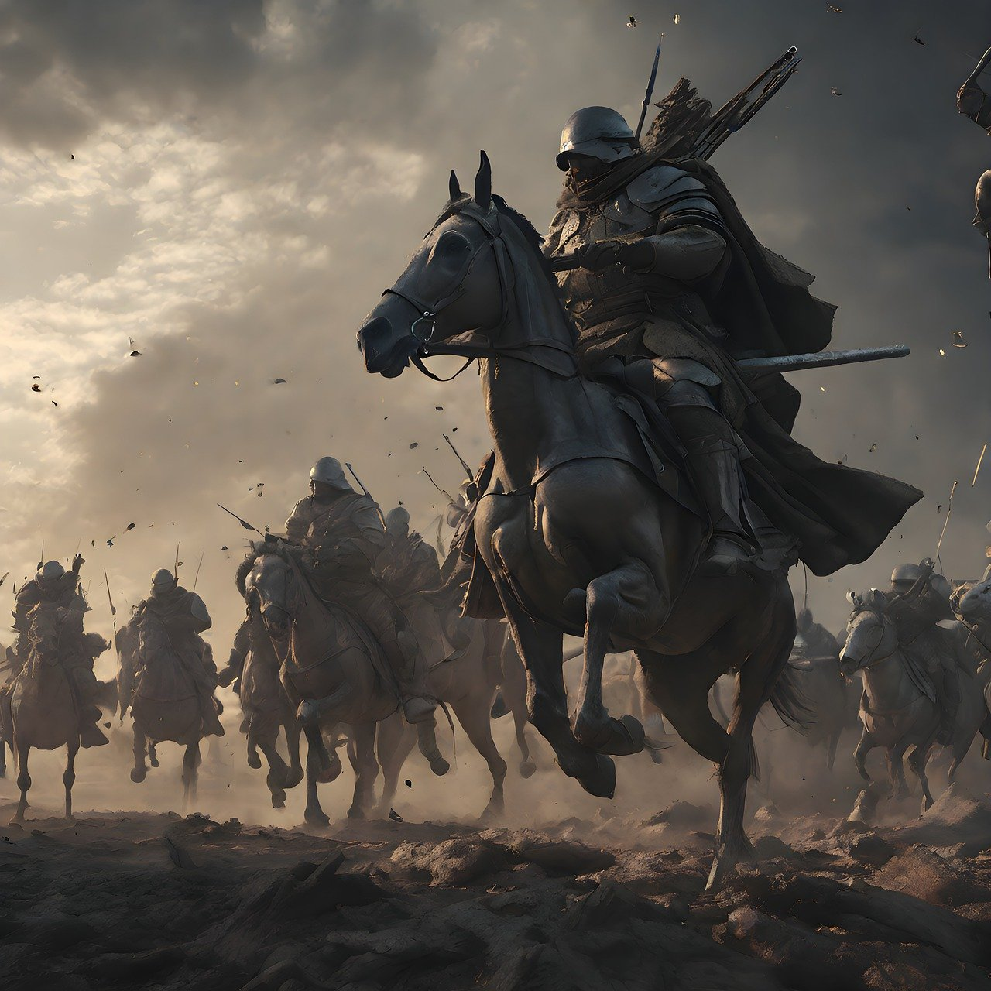
We're in a battle;
let's stand firm (v10-13)

Slide 5
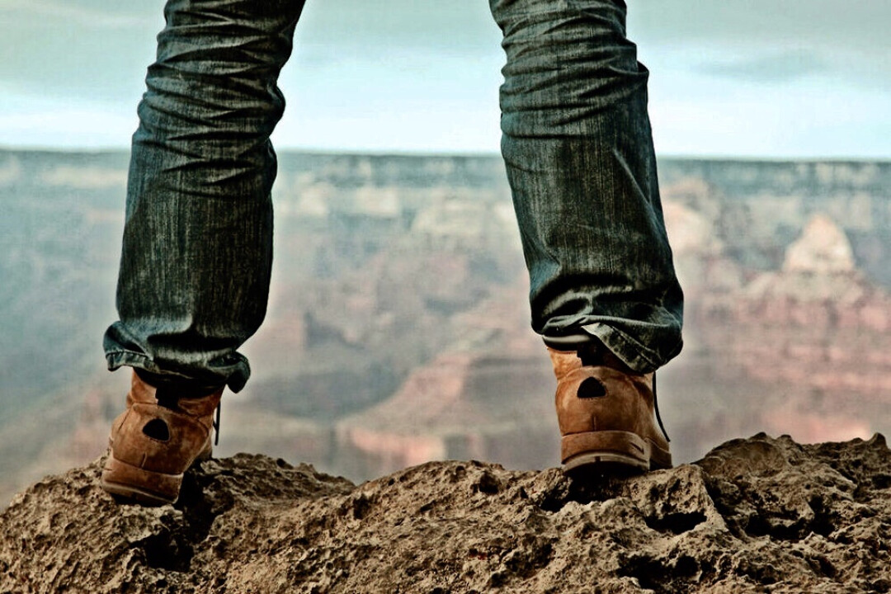
stand firm

Slide 6
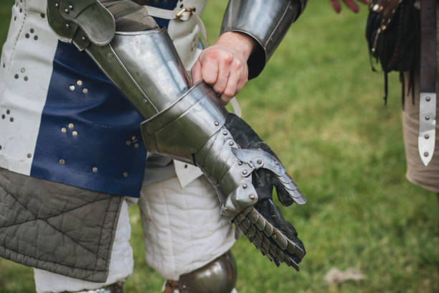
2. We've been given armour;
let's put it on (v14-17)

Slide 7
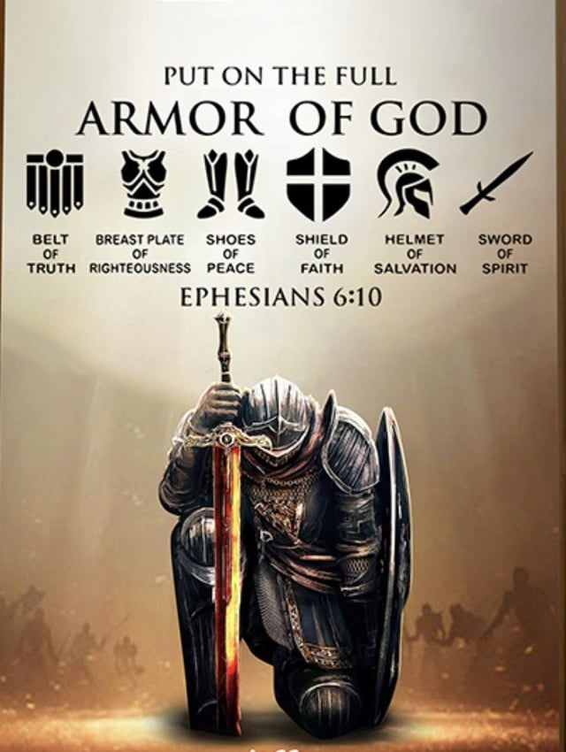

Slide 8
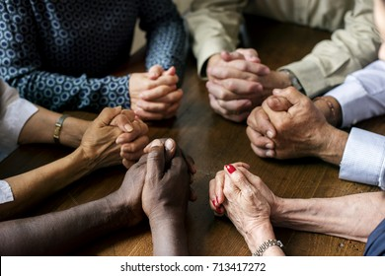
3. We're in this together;
let's pray (v18-24)

Slide 9
