Slide 2
God's new set of clothes

Slide 3
Realise your old sinful clothes are no good
Take off your old sinful clothes
Put on Jesus' glorious new clothes

Slide 4
Realise your old sinful clothes are no good

Slide 5
4v17
So I tell you this, and insist on it in the Lord, that you must no longer live as the Gentiles do

Slide 7
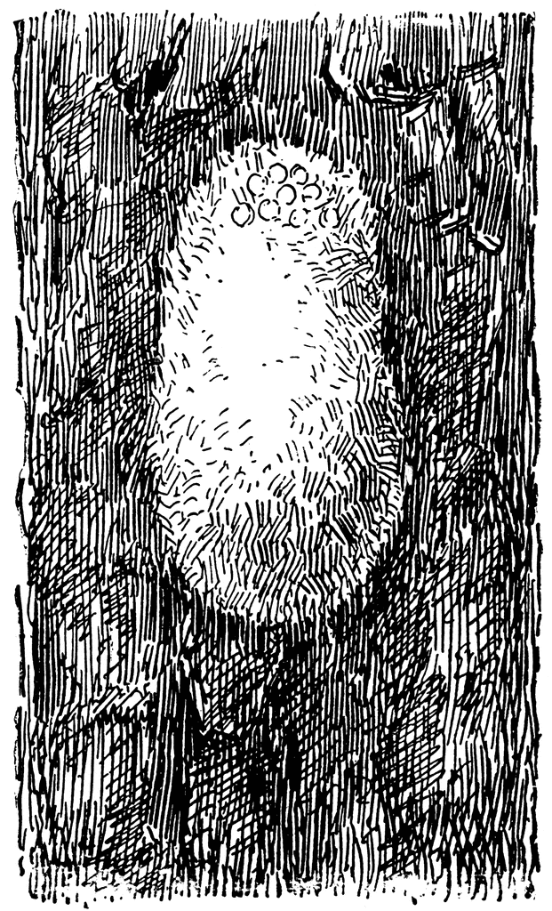

Slide 8
Realise your old sinful clothes are no good
Take off your old sinful clothes

Slide 9
4v22
You were taught, with regard to your former way of life, to put off your old self

Slide 10
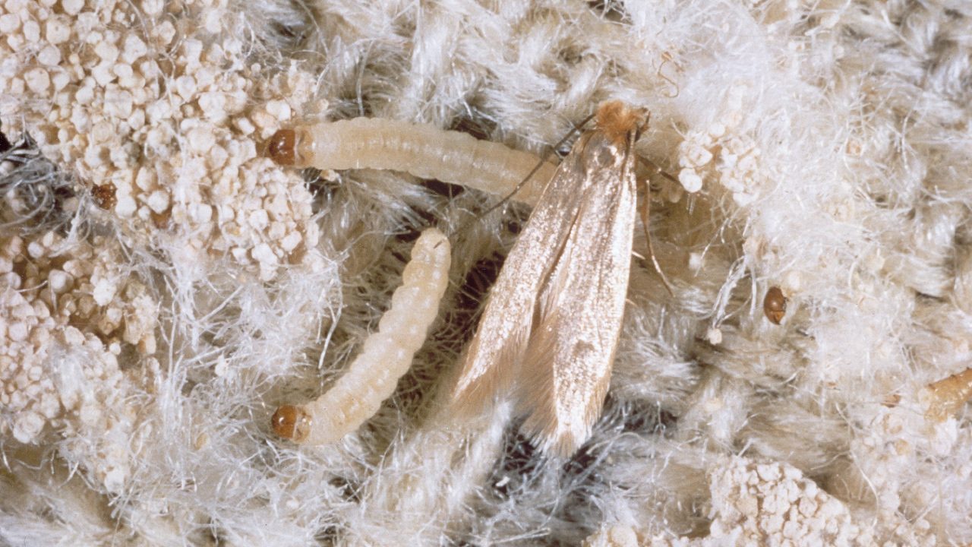
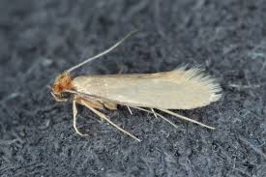
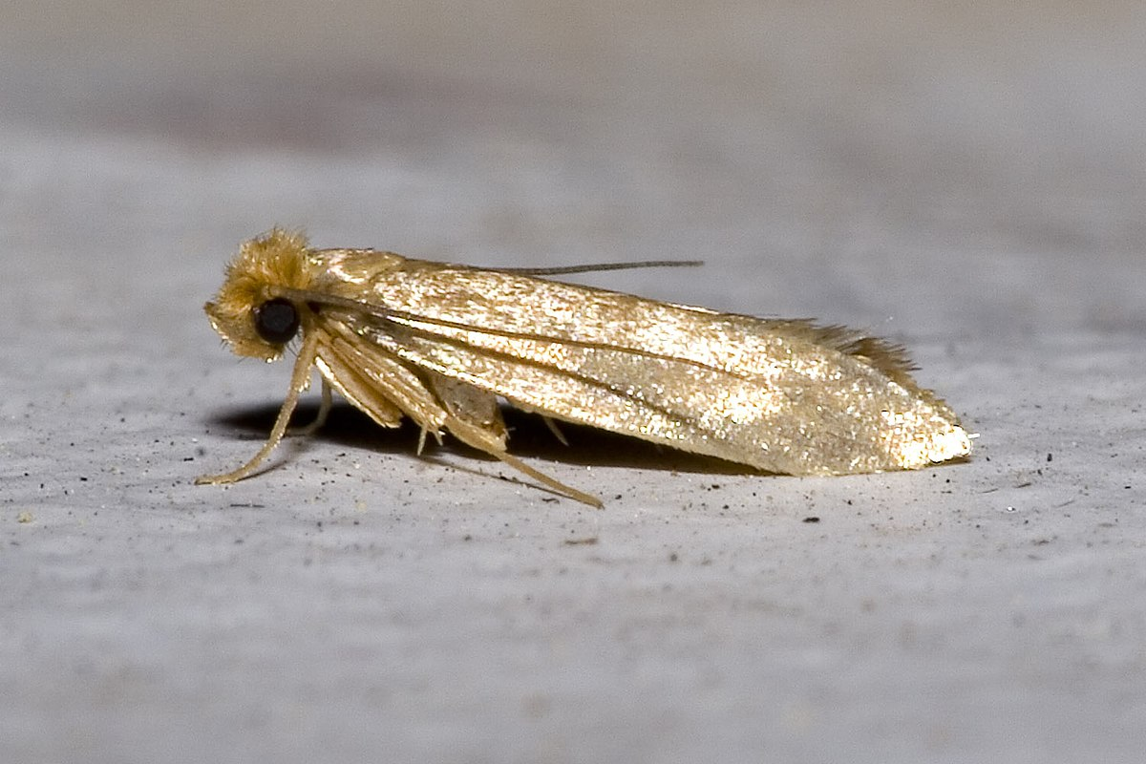

Slide 11
Realise your old sinful clothes are no good
Take off your old sinful clothes
Put on Jesus' glorious new clothes

Slide 12
4v22-24
You were taught, with regard to your former way of life, to put off your old self, which is being corrupted by its deceitful desires; to be made new in the attitude of your minds; and to put on the new self, created to be like God in true righteousness and holiness.

Slide 13
4v22-24
You were taught, with regard to your former way of life, to put off your old self, which is being corrupted by its deceitful desires; to be made new in the attitude of your minds; and to put on the new self, created to be like God in true righteousness and holiness.

Slide 15
Jesus' new set of clothes

