Slide 1
Matthew Mark Luke John

Slide 2
The Word became flesh and made his dwelling among us.

Slide 3
God coming

Slide 4
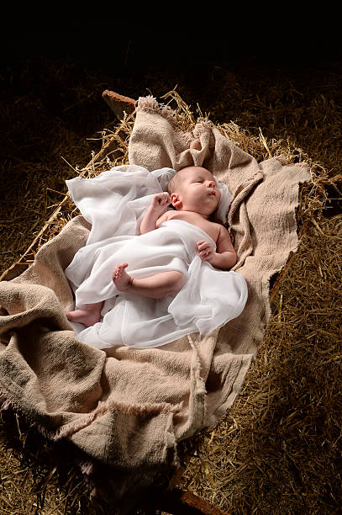
God became a human being

Slide 5
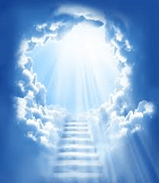

Slide 6
The Word became flesh and made his dwelling among us.

Slide 7
God became a human being

Slide 8
2. God came to be with us

Slide 9
The Word became flesh and made his dwelling among us.

Slide 10
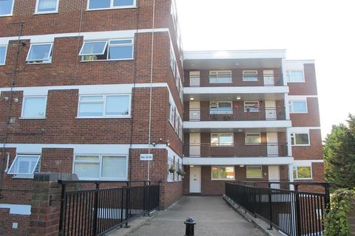
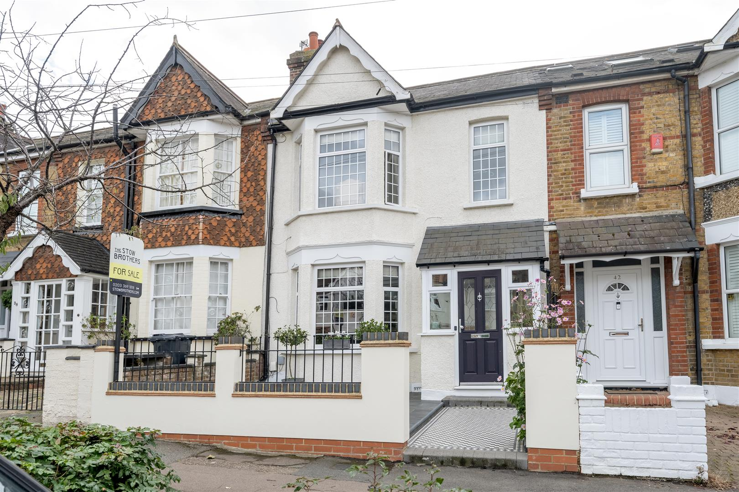
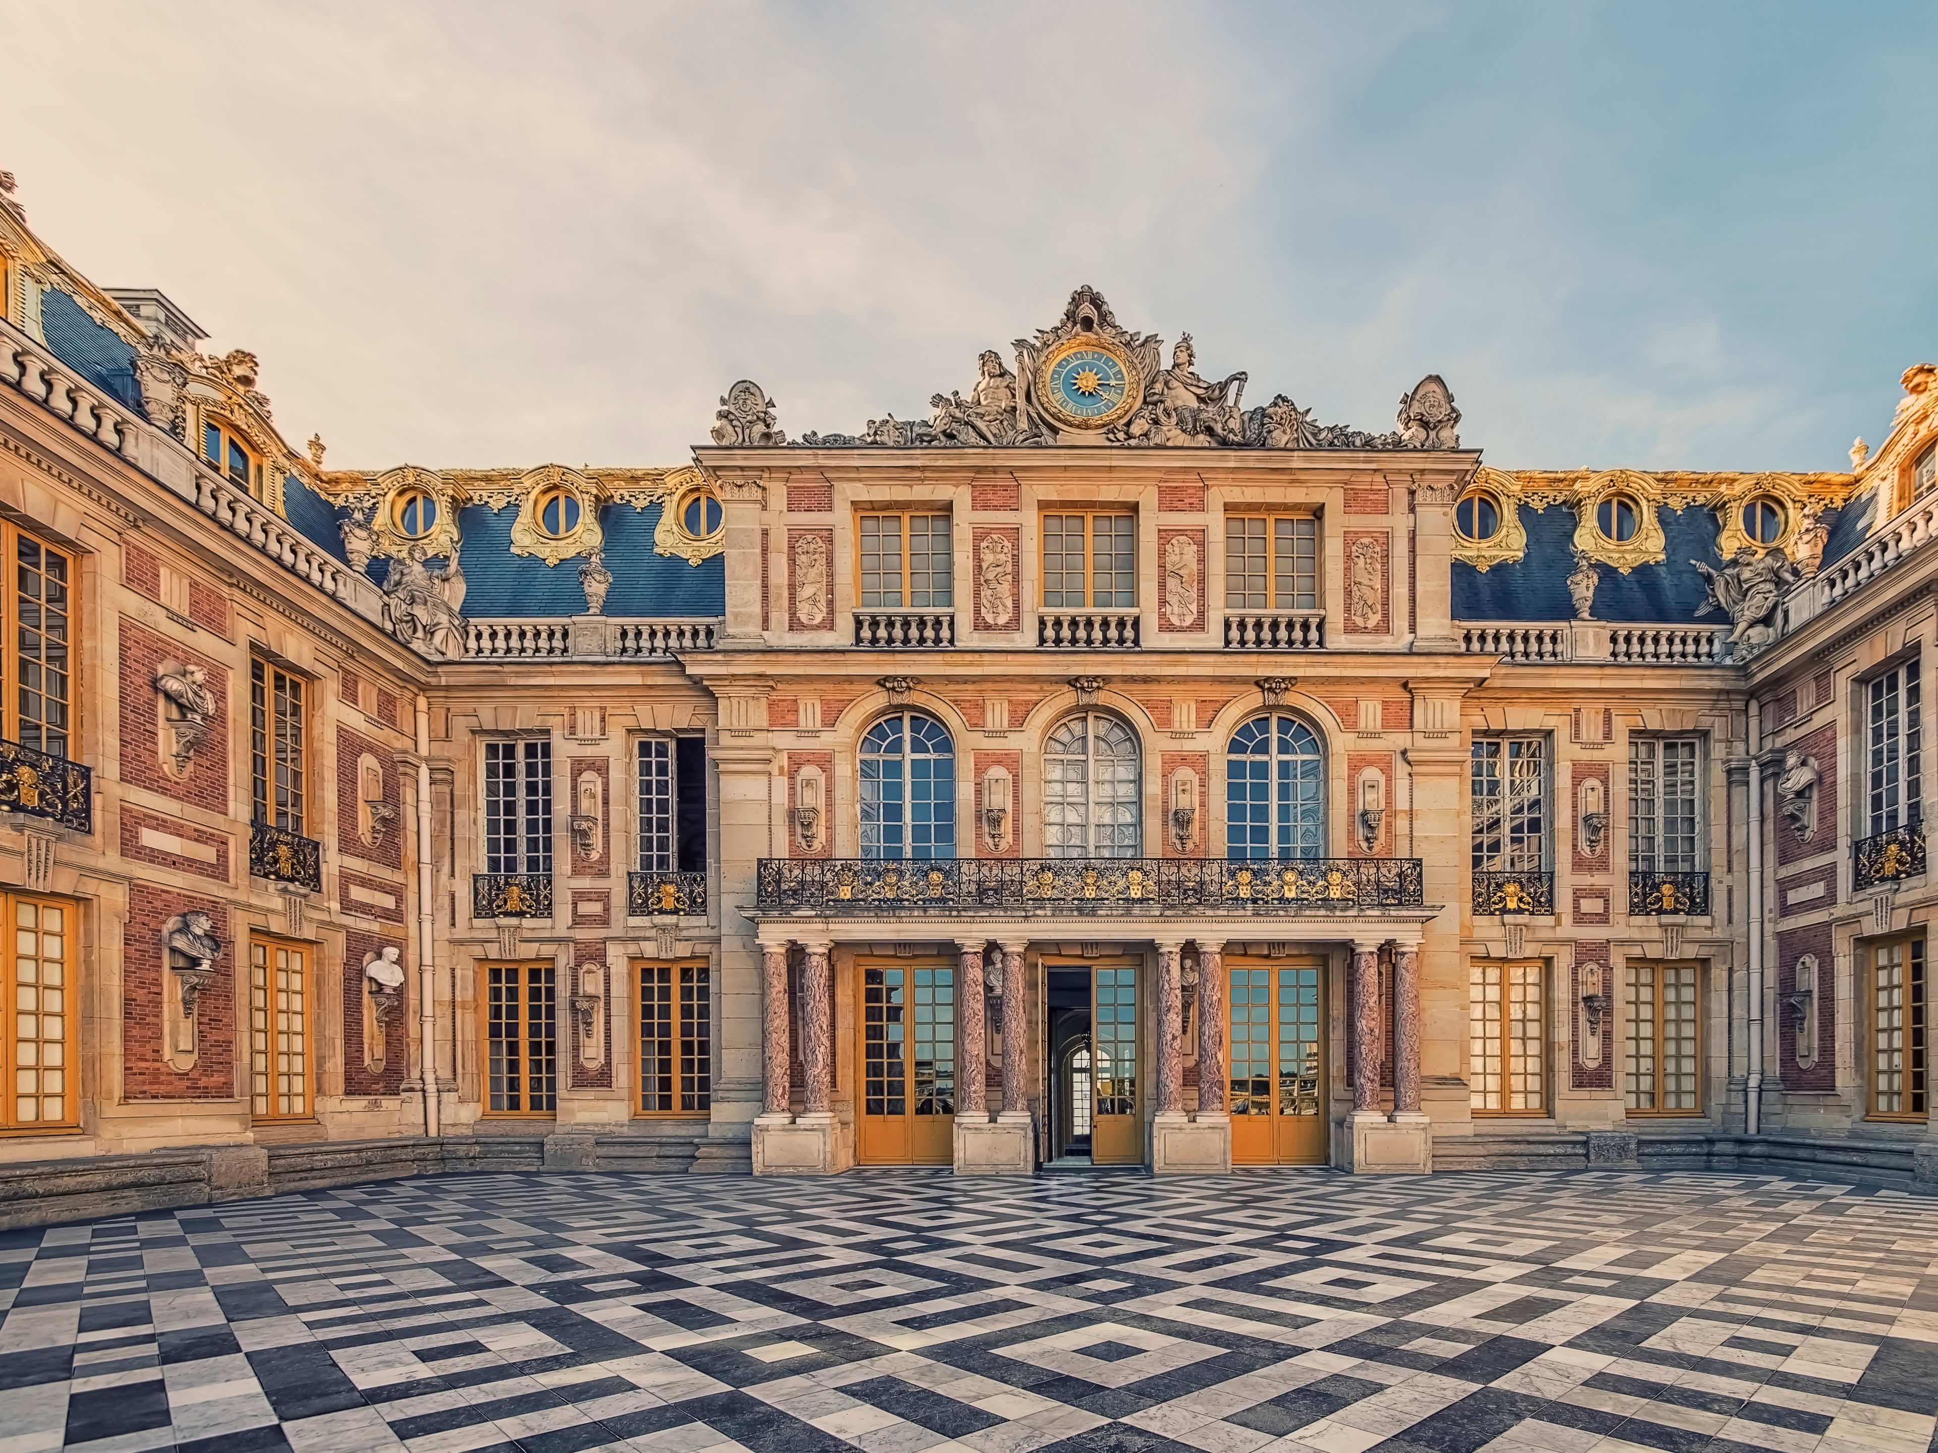
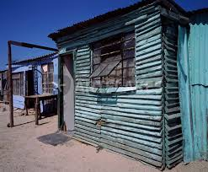
dwelling = where you live

Slide 11
make a dwelling
= make it your home

Slide 12
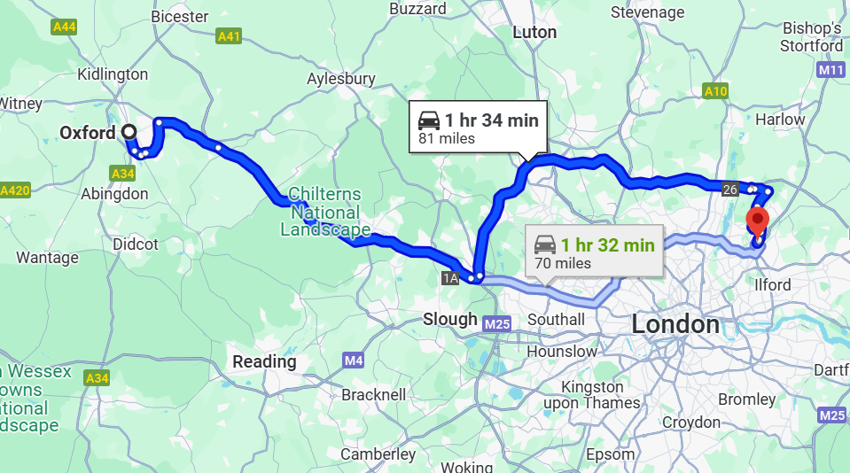

Slide 14
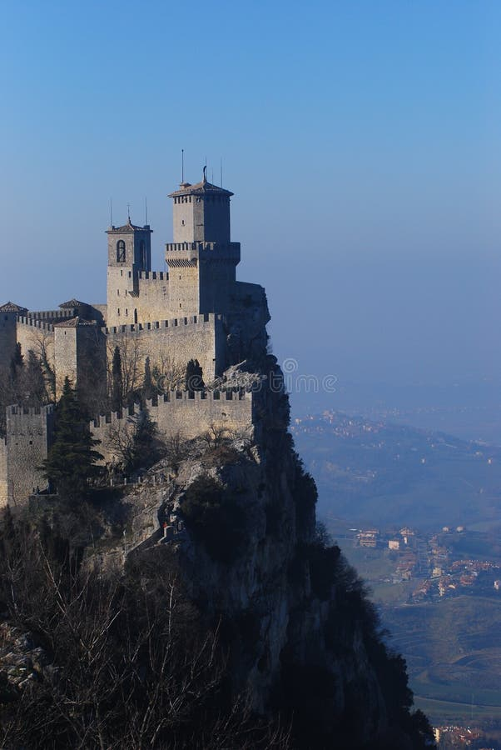

Slide 15
2. God came to be with us

Slide 16
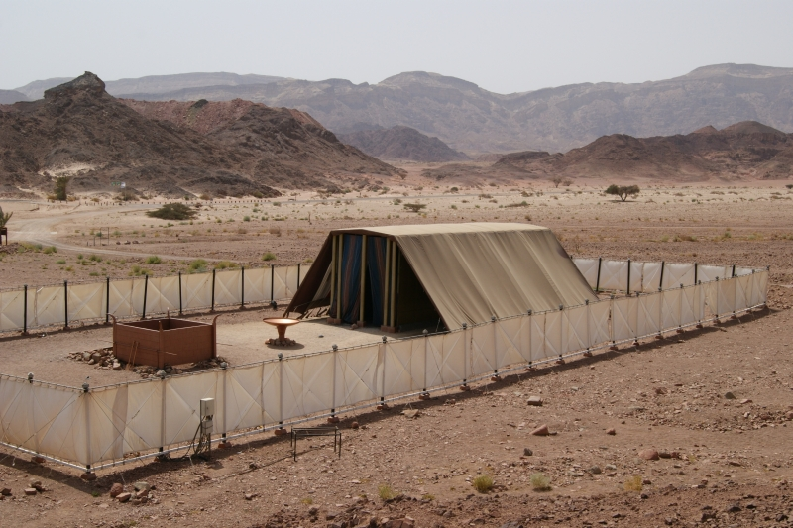
tabernacle

Slide 17
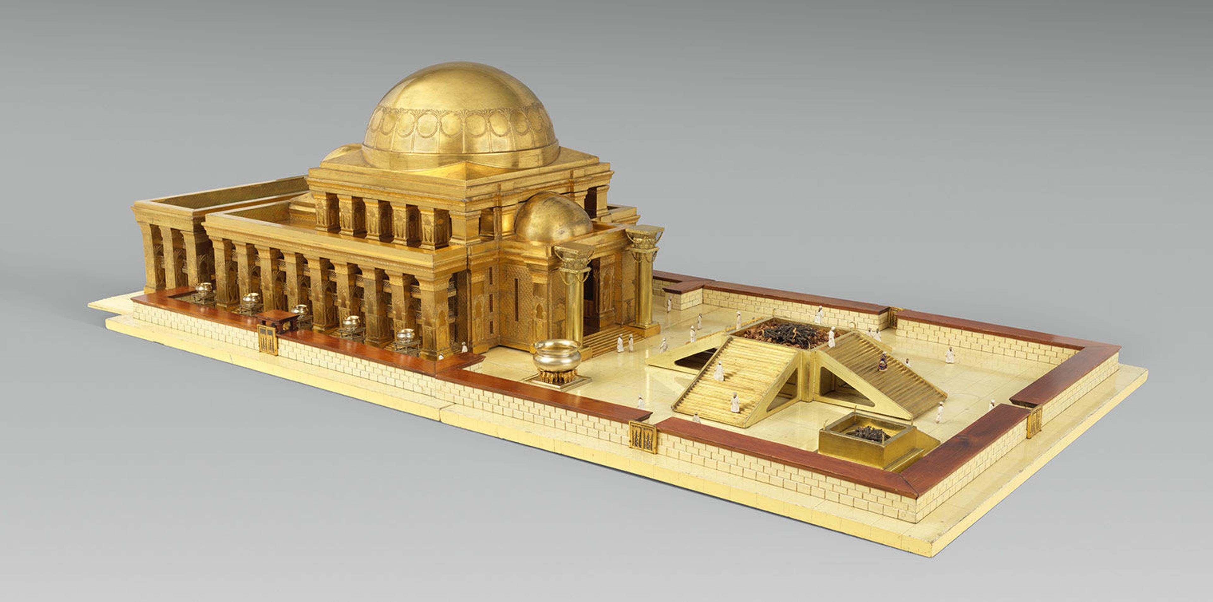
temple

Slide 18
2. God came to be with us

Slide 19
3. God showed us his glory

Slide 20
The Word became flesh and made his dwelling among us. We have seen his glory, the glory of the one and only Son who came from the Father, full of grace and truth.

Slide 21
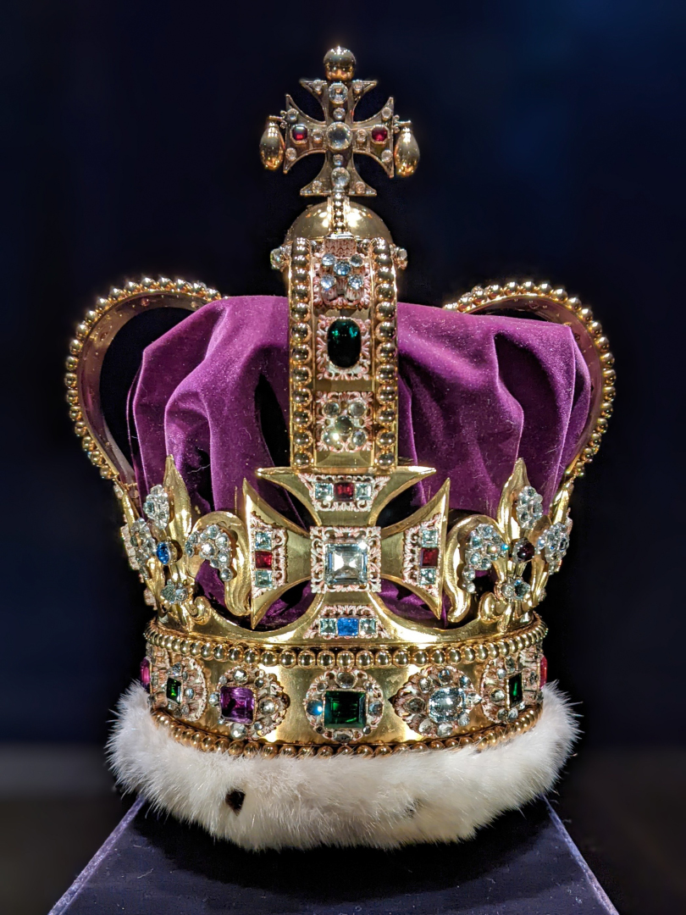
glory

Slide 22
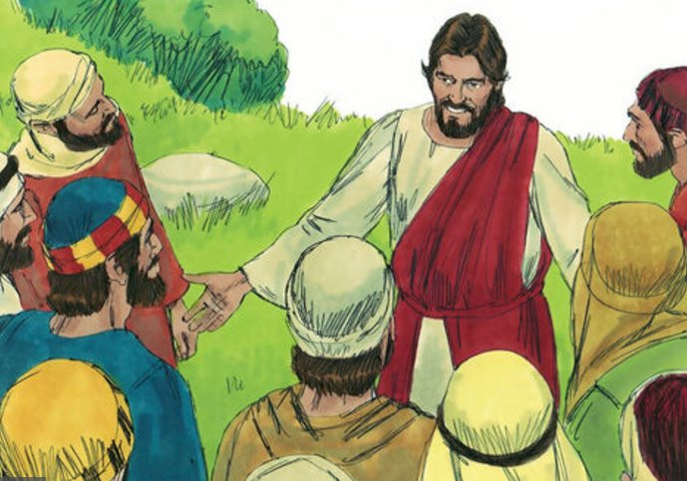

Slide 23
glory

Slide 24
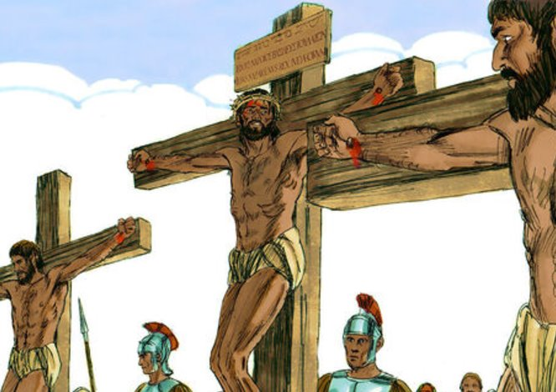

Slide 25
in Jesus, God came

