Slide 3
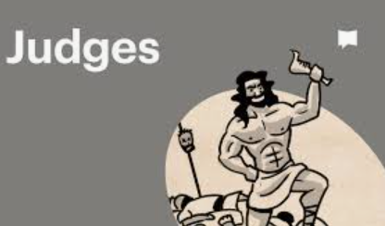

Slide 4
These things happened to them as examples and were written down as warnings for us
1 Corinthians 10:11

Slide 5
These things happened
to them as examples and were written down as warnings for us
1 Corinthians 10:11

Slide 6
A conquest that started so well but failed to deliver (chapter 1)

Slide 7
Victories won (v1-19):
Bezek (v4-7)
Jerusalem (v8)
Hebron (v10)
Debir (v11-15)
Gaza (v18)
Ashkelon (v18)
Ekron (v18)

Slide 8
Why such success?
The LORD was with them (v19)
The LORD fought for them (v2)

Slide 9
Failures (v19-36):
lowlands (19-21)
Bethel? (v22-26)
the 6 tribes who failed to drive out Canaanites (v27-36)

Slide 10
A conquest that started so well but failed to deliver (chapter 1)
2. A people who chose compromise over compliance (2v1-5)

Slide 11
God's speech (v1-3)
All he had done for them (v1)
What he'd said to them (v2)
What he'd commanded of them (2
His verdict on what they'd done (v2)
The consequences he'd warned them of (v3)

Slide 12
But hang on...?
This was a one-time event in history

Slide 13
But hang on...?
This was a one-time event in history
The Canaanites were evil

Slide 14
But hang on...?
This was a one-time event in history
The Canaanites were evil
The command was to drive them out not wipe them out

Slide 15
But hang on...?
This was a one-time event in history
The Canaanites were evil
The command was to drive them out not wipe them out
Their removal was essential for Israel's survival

