Slide 1
Is Jesus big enough?

Slide 2
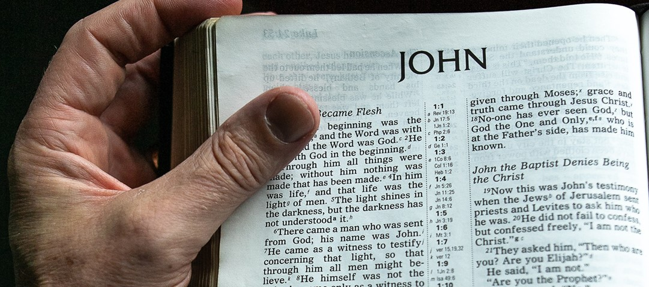

Slide 3
Worship Jesus
… who is God (v1-2)

Slide 4
a God who speaks

Slide 5
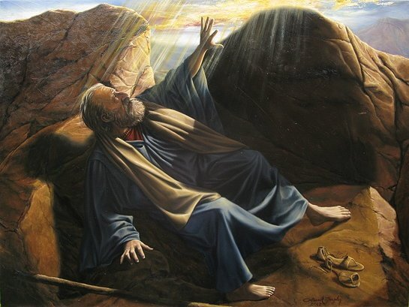

Slide 6
a God who speaks

Slide 8
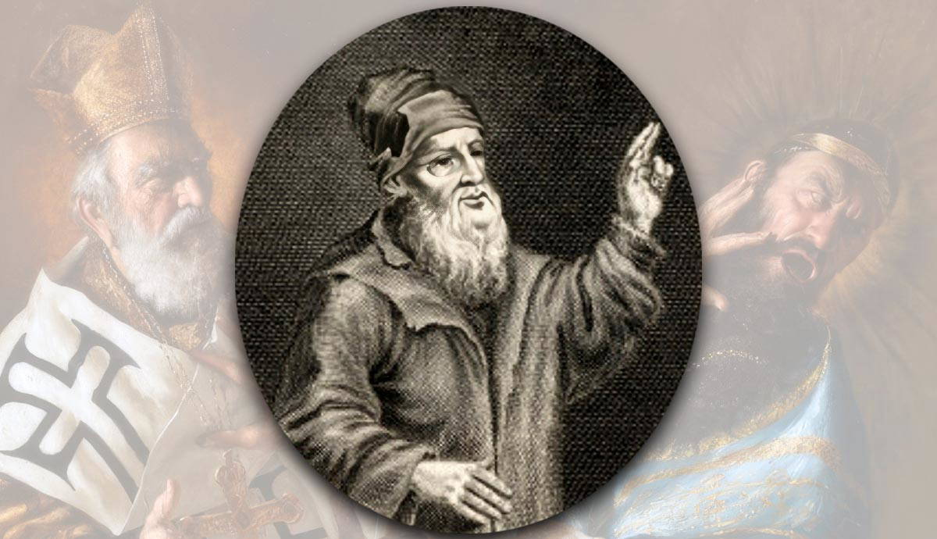
Arius
Jesus is great ...but he isn't God

Slide 9
Jehovah's Witnesses
Jesus is great ...but he isn't God

Slide 12
2. Worship Jesus
… who is our maker
(v3-5)

