Slide 2
Ephesians 3:13
I ask you, therefore, not to be discouraged because of my sufferings for you, which are your glory.

Slide 4
Jewish believers
Gentile believers

Slide 8
his intent was that now, through the church, the manifold wisdom of God should be made known to the rulers and authorities in the heavenly realms

Slide 9
power

Slide 10
Paul prays for power...
(v14-16)

Slide 11
v16: I pray that out of his glorious riches he may strengthen you with power

Slide 12
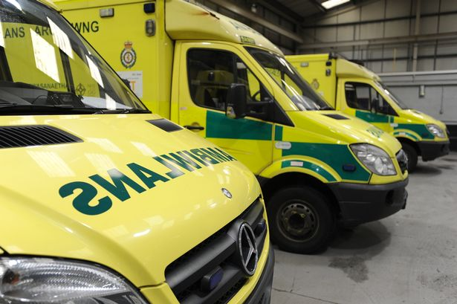

Slide 13
Paul prays for power
...to better know Christ's love, presence & glory
(v17-19)

Slide 14
v17: that Christ may dwell in your hearts through faith

Slide 15
v18: ...to grasp how wide and long and high and deep is the love of Christ

Slide 16
v19: that you may be filled to the measure of all the fullness of God

Slide 17
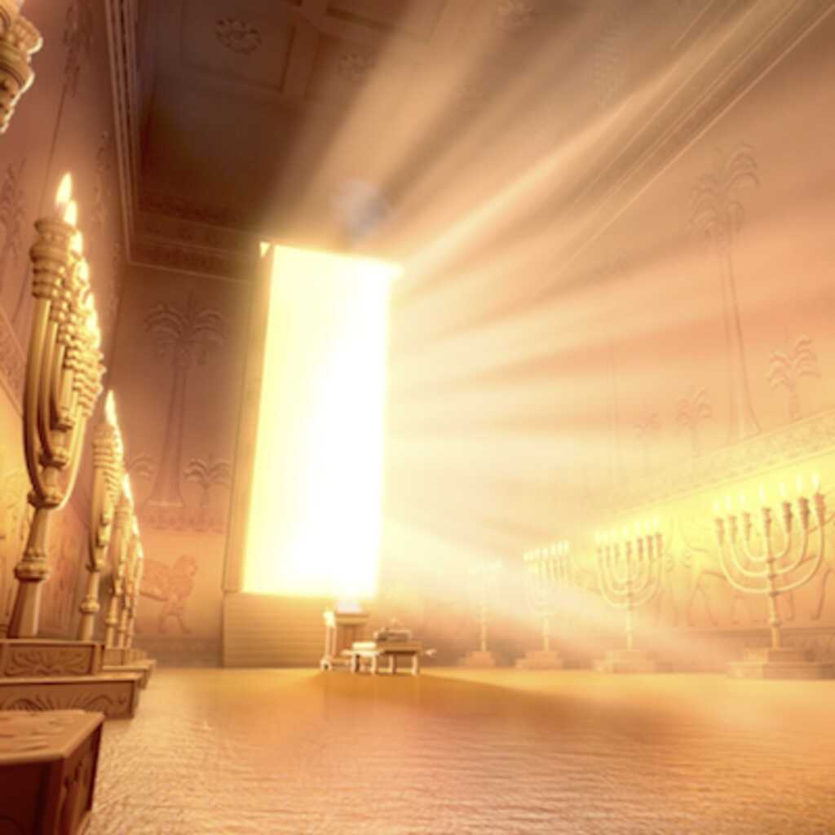

Slide 18
Power for...
v17: dwelling
v18: grasping
v19: filling

Slide 20
Paul prays for power
to better know Christ's love, presence & glory
...to the God who is all powerful
(v20-21)

