Slide 1
‘You can use money to show that you value it more than Christ.
Or you can use it to show that you value Christ more than money.’
(Living in the Light: John Piper)

Slide 2
The God who keeps us going….
(Psalm 125)

Slide 3
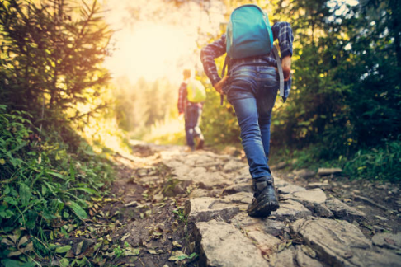
The God who keeps us going….
(Psalm 125)
A Picture of Stability: vs 1-2

Slide 4
The God who keeps us going….
(Psalm 125)
A Picture of Stability: vs 1-2
A Promise of Restraint: vs 3

Slide 5
The God who keeps us going….
(Psalm 125)
A Picture of Stability: vs 1-2
A Promise of Restraint: vs 3
A Prayer for Peace: vs 4-5

