Slide 2
v1-5: who Jesus is
v6-13: how Jesus came & how he was received

Slide 3
The light who was coming
(6-9)

Slide 4
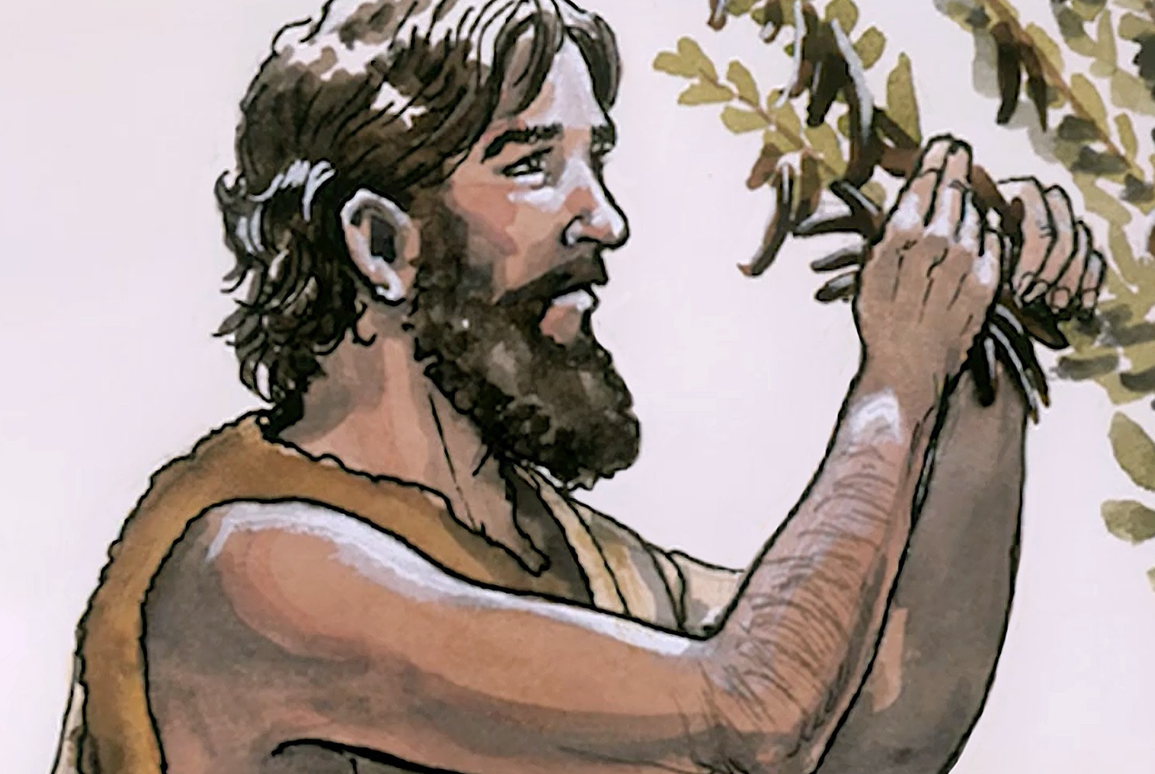
John the Baptist

Slide 5
John the Baptist
was not the Messiah

Slide 6
John the Baptist
was a witness to the Messiah

Slide 7
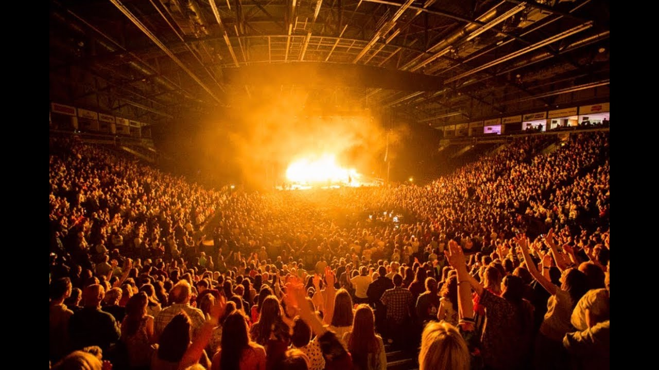

Slide 8
2. The light who has come
(v10-13)

Slide 9
3 responses to Jesus
the world's indifference (v10)

Slide 10
3 responses to Jesus
the world's indifference (v10)
the Jewish people's rejection (v11)

Slide 11
3 responses to Jesus
the world's indifference (v10)
the Jewish people's rejection (v11)
the Christians' faith (v12-13)

